Slide 1
Nyss Training Guide
Note to instructors
The computer-based training guide serves as an introductory supplement to the Nyss training manual. With the support of an instructor, the guide gives a step-by-step introduction for relevant personnel to the Nyss platform.
The training guide consists of several modules that each cover different functionalities of the platform. For each module, the instructor gives a demo for a specific functionality or page, before participants engage in task-solving on their own devices (PC, tablet, smartphone).
Version 1.0

Slide 2
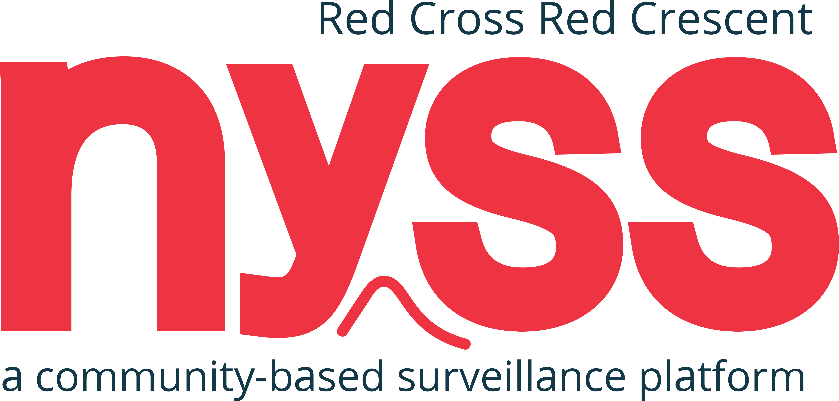

Slide 3
CBS: Localized response early in outbreak
Cases
Late detection and response, due to lacking surveillance
Early response with CBS and Nyss
epidemic curve
TIME
CBS enables early detection and early action

Slide 4
Training Guide Contents
About Nyss
Demo and tasks
Questions and discussion

Slide 5
Training Guide Methodology
DEMOS
TASKS
The participants test the platform through task-solving
Explanation of the content

Slide 6
1. ABOUT NYSS

Slide 7
What is Nyss?
ABOUT NYSS
Software platform for community-based surveillance (CBS) of health risks and other unusual events in local communities.
CBS is defined as the systematic detection and reporting of events of public health significance within a community by community members.
In communities with poor health service coverage and weak surveillance systems, CBS and Nyss can be used to ensure early warning and early response to disease outbreaks and epidemics, both for preparedness and in emergencies.
Nyss makes it possible to collect and react to data in real-time.
n y s s
[nyss] · Norwegian
(n.) having learned or found out about something

Slide 8
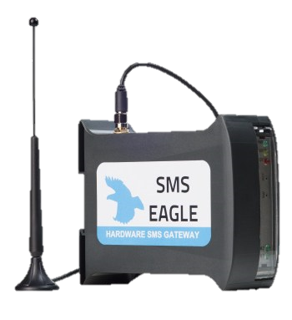
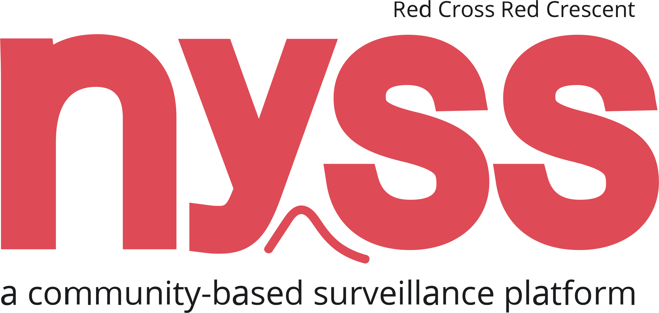
Technical structure
ABOUT NYSS
Feature phones
Report health risks/events
Nyss makes it possible to collect and react to data in real time.
SMSEagle
Transmits reports
n y s s
[nyss] · Norwegian
(n.) having learned or found out about something
Nyss
Stores reports; aggregates and visualizes data

Slide 9
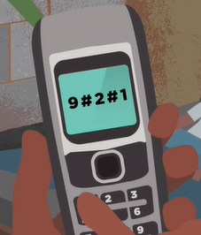
Feature phones
Report health risks/events
ABOUT NYSS
9 = health risk/event #9
2 = male
1 = 0-4 years old
Numbers are separated by hashes and must follow the structure of
health risk/event
Refer to the manual for more information on reporting to Nyss, including different types of reports
Nyss makes it possible to collect and react to data in real time.
#
sex
#
age
n y s s
[nyss] · Norwegian
(n.) having learned or found out about something

Slide 10
2. DEMOS AND TASKS

Slide 11
DEMOS AND TASKS
National Society
Dashboards
Reports
User list
Settings
Projects
Project Overview
Project Dashboard
Alerts
Data Collection
Project Reports
Project Settings

Slide 12
DEMOS AND TASKS
National Society
Dashboards
Reports
User list
Settings
Projects
Project Overview
Project Dashboard
Alerts
Data Collection
Project Reports
Project Settings

Slide 13
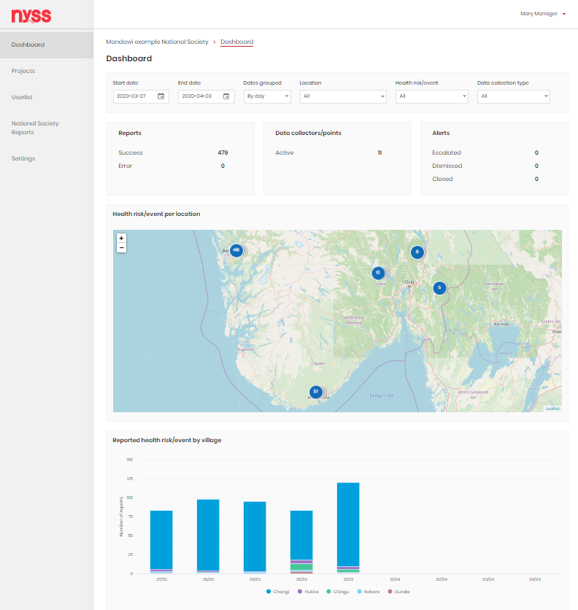
DEMOS AND TASKS
National Society
Dashboards
Reports
Userlist
Settings
Projects
Project Overview
Project Dashboard
Alerts
Data Collection
Project Reports
Project Settings

Slide 14
National Society
Dashboard
DEMO
Landing page for managers, also accessible by technical advisors and data consumers.
Aggregates reports from all projects within the National Society, and shows:
The geographical distribution of reported health risks/events
Health risks/events reported over time, shown in different graphs and tables
An overview of reports, data collectors and alerts
NYSS TRAINING GUIDE
Version 1.0

Slide 15
National Society
Dashboard
DEMO
Filter by:
Start and end date
Dates grouped (by day or EPI week)
Location (regions, districts or villages; to focus on specific areas)
Health risk/event
Data collection type (data collectors or data collection points)
NYSS TRAINING GUIDE
Version 1.0
Notes:
By default, the dashboard shows data from the past 7 days

Slide 16
National Society
Dashboard
DEMO
Visible data:
Reports + status: Success = Nyss was able to interpret the report
Data collectors/points
Alerts + states
Map of health risks/events per location
Several charts and tables further down
NYSS TRAINING GUIDE
Version 1.0

Slide 17
National Society
Dashboard
TASKS
Answers to some questions:
Health risk tile/box shows the number of error reports
Data collectors/points shows the number of active data collectors
Escalated: Supervisor cross-checked and notified health authorities, Dismissed: Supervisor cross-checked and found the alert to not be valid, Closed: Escalated and health authorities have dealt with it
Click on one of the circles on the map until it zooms in enough to show only one data collector. Click that data collector will open a tooltip with info.
Number of reports per health risk/event grouped by day or epi week. The 10 villages with the highest number of reports are separated, the rest are grouped under “Other villages”
Play a little with the different filters in the box at the top. Do you know what all of them do and why they might be useful?
How many error reports have been sent the last week in the whole country?
How many data collectors are currently active in the National Society?
Which health risks/events are reported on in this national society?
Check the alert box. Do you know what these different states might mean?
Can you find out how many reports a particular location sent of a particular health risk/event using the map?
What kind of information can you gather from the infographics under the map?
Instructions:
Log into Nyss
Answer the questions
NYSS TRAINING GUIDE
Version 1.0

Slide 18
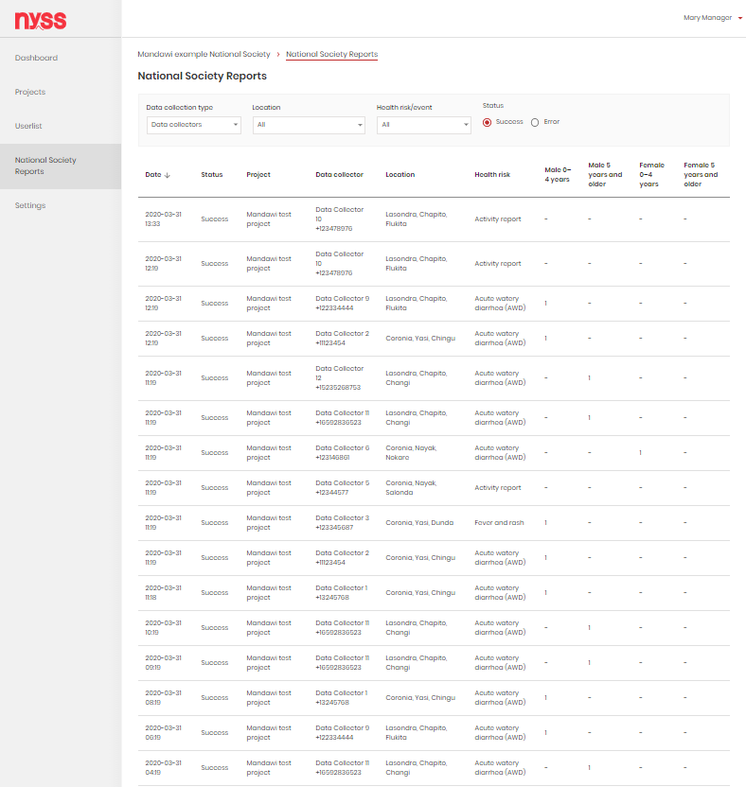
DEMOS AND TASKS
National Society
Dashboards
Reports
User list
Settings
Projects
Project Overview
Project Dashboard
Alerts
Data Collection
Project Reports
Project Settings

Slide 19
National Society
Reports
DEMO
Only accessible by managers and technical advisors.
Aggregates reports from all projects within the National Society and shows details of each report.
Can be filtered by:
Data collection type
Location
Health risk/event
Status
NYSS TRAINING GUIDE
Version 1.0

Slide 20
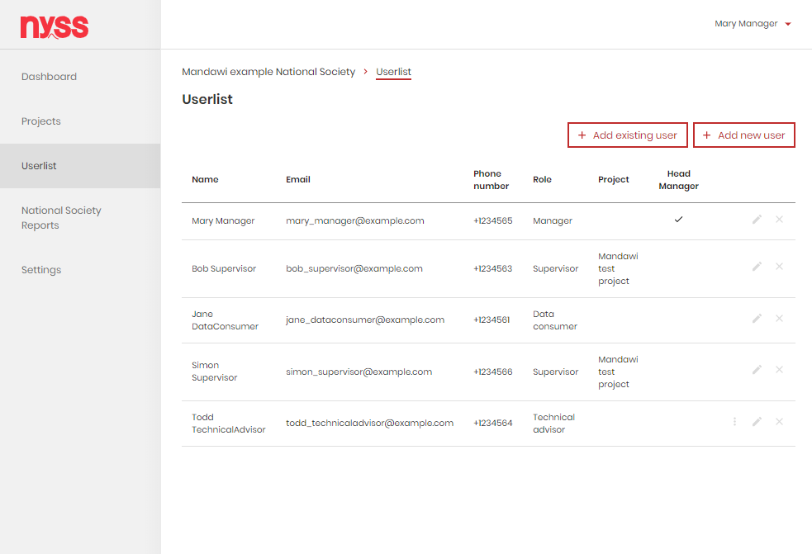
DEMOS AND TASKS
National Society
Dashboards
Reports
User list
Settings
Projects
Project Overview
Project Dashboard
Alerts
Data Collection
Project Reports
Project Settings

Slide 21
National Society
User list
DEMO
Only accessible by managers and technical advisors.
Gives an overview of all users and their details.
Possible to:
Add existing user
Add new user
Edit user
Delete user
Assign Head manager role
NYSS TRAINING GUIDE
Version 1.0
Notes:
Relevant for:
Global Coordinator
Managers (Head manager, Manager, Technical Advisor)

Slide 22
National Society
User list
DEMO
Add existing user:
Technical Advisors and Data Consumers can be added to multiple National Societies.
NYSS TRAINING GUIDE
Version 1.0
Notes:
Relevant for:
Global Coordinator
Managers (Head manager, Manager, Technical Advisor)

Slide 23
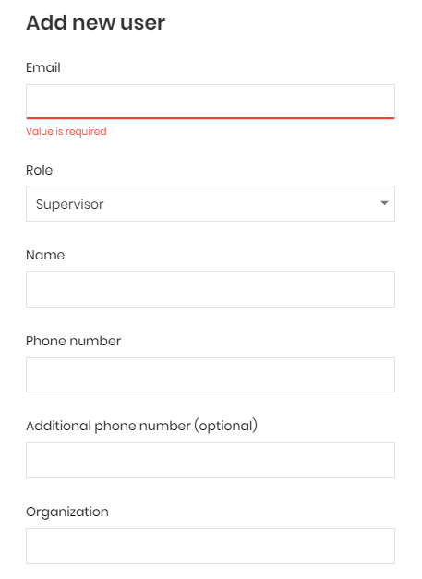
National Society
User list
DEMO
Add new user:
Choosing Supervisor in the role fields reveals additional mandatory fields
NYSS TRAINING GUIDE
Version 1.0
Notes:
Relevant for:
Global Coordinator
Managers (Head manager, Manager, Technical Advisor)

Slide 24
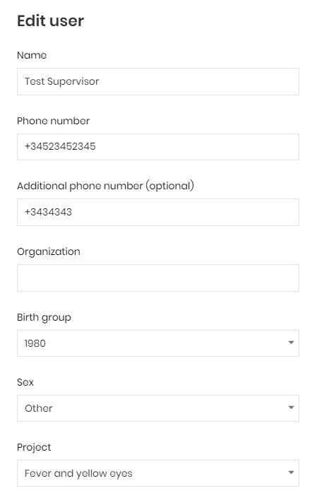
National Society
User list
DEMO
Edit user:
Existing users can be edited
To change the email address, they need to be deleted and re-added
Supervisors have these additional fields
NYSS TRAINING GUIDE
Version 1.0
Notes:
Relevant for:
Global Coordinator
Managers (Head manager, Manager, Technical Advisor)

Slide 25
National Society
User list
TASKS
Instructions
Log into Nyss
Answer the questions
Add users with the different access levels to the National Society.
Log in with the different users and make yourself familiar with the different functionality they can see.
Edit one of the users you made in the previous task.
Delete one of the users you made in the previous task.
NYSS TRAINING GUIDE
Version 1.0

Slide 26
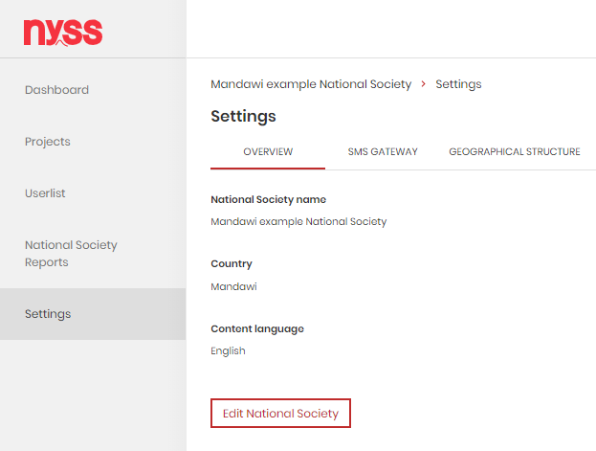
DEMOS AND TASKS
National Society
Dashboards
Reports
User list
Settings
Projects
Project Overview
Project Dashboard
Alerts
Data Collection
Project Reports
Project Settings

Slide 27
National Society
Settings
DEMO
Only accessible by managers and technical advisors.
Overview
Content language is the default language for all users within the National Society
NYSS TRAINING GUIDE
Version 1.0
Notes:
Relevant for:
Global Coordinator
Managers (Head manager, Manager, Technical Advisor)

Slide 28
National Society
Settings
DEMO
SMS Gateway
Nyss needs to know how to match incoming reports to National Societies
To achieve this, an SMS gateway is set up and added to the National Society.
Existing gateways can be removed or edited
Refer to Nyss user manual for more information
NYSS TRAINING GUIDE
Version 1.0
Notes:
Relevant for:
Managers (Head manager, Manager, Technical Advisor)

Slide 29
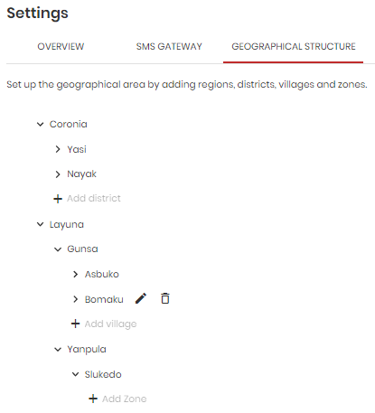
National Society
Settings
DEMO
Geographical structure
The geographical structure of your National Society needs to be set up manually
These are the locations that are available to select upon registrations of data collectors/data collection points
4 levels: Regions, districts, villages and zone (optional)
You can add/edit or remove locations
NYSS TRAINING GUIDE
Version 1.0
Notes:
Relevant for:
Managers (Head manager, Manager, Technical Advisor)

Slide 30
DEMOS AND TASKS
National Society
Dashboards
Reports
User list
Settings
Projects
Project Overview
Project Dashboard
Alerts
Data Collection
Project Reports
Project Settings

Slide 31
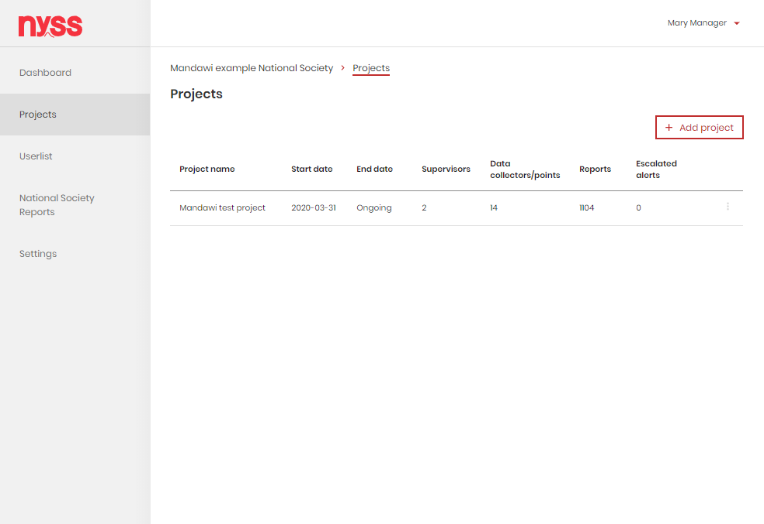
DEMOS AND TASKS
National Society
Dashboards
Reports
User list
Settings
Projects
Project Overview
Project Dashboard
Alerts
Data Collection
Project Reports
Project Settings

Slide 32
Projects
Projects list
DEMO
Accessible by managers, technical advisors and data consumers.
Gives an overview of:
All projects in one national society
Possible to:
Add project
Close project
NYSS TRAINING GUIDE
Version 1.0
Notes:
Possible to add project and close project (only managers + technical advisors).

Slide 33
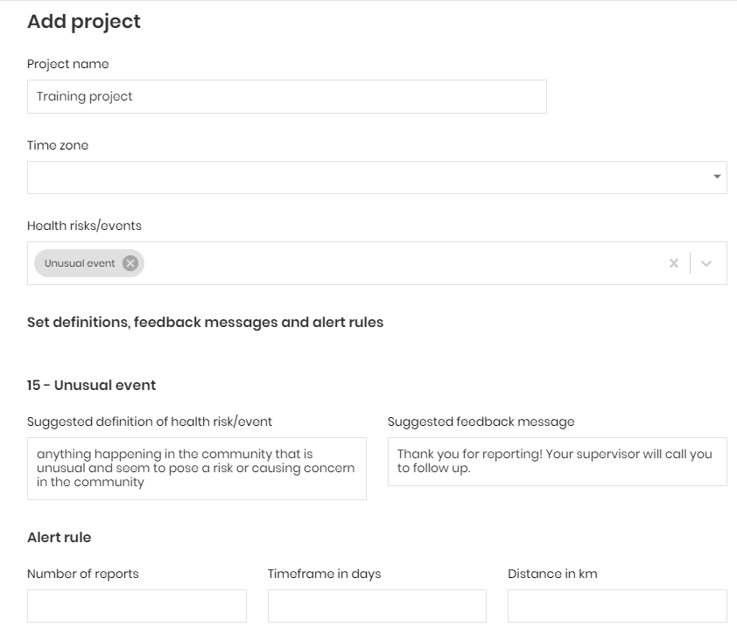
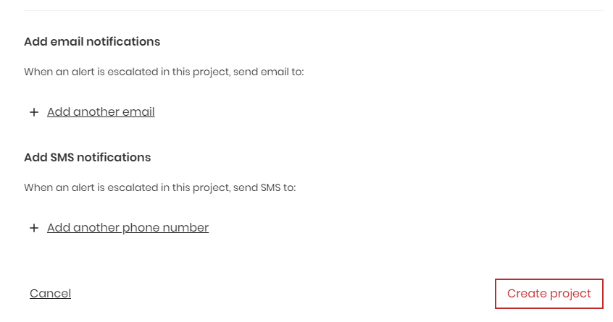
Projects
Project overview
DEMO
Add project:
Project name
Time Zone
Health risks/events
Configure community definitions, feedback messages and alert rules
Add email and phone number for alert notifications
NYSS TRAINING GUIDE
Version 1.0
Notes:
Only managers

Slide 34
Projects
Project overview
TASKS
Instructions:
Log into Nyss
Answer the questions
Answers:
No because each report triggers an alert, and thus collecting multiple over a timeframe of 7 days does not make sense.
Activity and/or zero reports, since they enable Data Collectors to show they are still active, even if they don’t report+Unusual event.
The one of the country or region you are implementing in.
All data collectors in that project will be removed, but the reports themselves will still be accessible (pseudonymized). The projects stays in the list and the dashboard can still be visited.
What is important to know before adding a new project?
Can you think about what you need to consider before making alert rules?
Which health risks/events should be present in many contexts?
Which time zone do you configure?
Add a new project in Nyss. Set up some reasonable alert rules.
What happens if you close a project?
NYSS TRAINING GUIDE
Version 1.0
Notes:
Only for managers

Slide 35
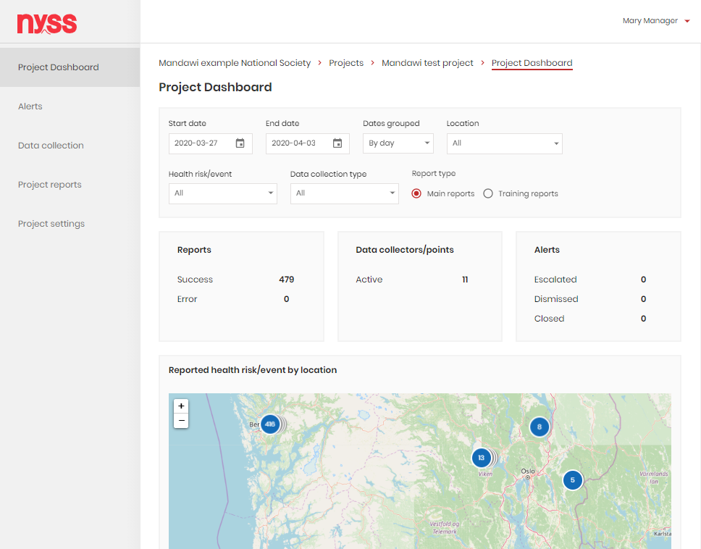
DEMOS AND TASKS
National Society
Dashboards
Reports
User list
Settings
Projects
Project Overview
Project Dashboard
Alerts
Data Collection
Project Reports
Project Settings

Slide 36
Projects
Project Dashboard
DEMO
Landing page for supervisors, also accessible by managers, technical advisors and data consumers.
Aggregates reports across one project, and shows:
The geographical distribution of reported health risks/events
Health risks/events reported over time, shown in different graphs and tables
An overview of reports, data collectors and alertsAlert states
NYSS TRAINING GUIDE
Version 1.0

Slide 37
Projects
Project Dashboard
DEMO
Can be filtered by:
Timeframe
Dates grouped
Location
Health risk/event
Data collection type
Main/Training reports (not on National Society dashboard)
Visible data:
Report quality
Data collectors/data collection points
Alert states
Map of reported health risks/events
NYSS TRAINING GUIDE
Version 1.0

Slide 38
Projects
Project Dashboard
DEMO
Bar chart: Number of reports by health risk/event
The number of reports per health risks grouped by day or epi week
Upon hovering it shows the number of reports
By clicking on the health risks/events in the legend you can in-/exclude what is shown in the chart
NYSS TRAINING GUIDE
Version 1.0

Slide 39
Projects
Project Dashboard
DEMO
Bar chart: Reported health risk/even by village
The total number of reports of the 10 villages with the highest number of reports
All other villages are grouped under “Other villages”
Upon hovering it shows the number of reports
By clicking on the health risks/events in the legend you can in-/exclude what is shown in the chart
NYSS TRAINING GUIDE
Version 1.0

Slide 40
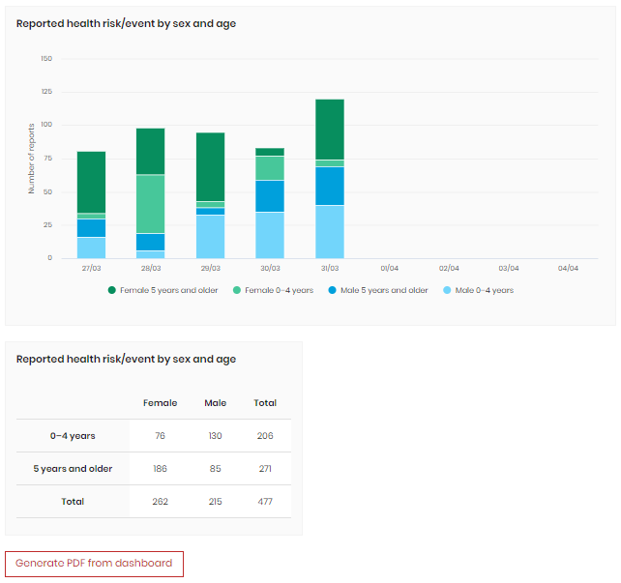
Projects
Project Dashboard
DEMO
Bar chart: Reported health risk/event by sex and age
The total number of reports of human health risks per sex and age in a bar chart
Upon hovering it shows the number of reports
By clicking on the health risks/events in the legend you can in-/exclude what is shown in the chart
NYSS TRAINING GUIDE
Version 1.0

Slide 41
Projects
Project Dashboard
DEMO
Table: Reported health risk/event by sex and age
The total number of reports of human health risks per sex and age in a table
You can export all the graphs from the dashboard to a PDF with the Generate PDF button
NYSS TRAINING GUIDE
Version 1.0

Slide 42
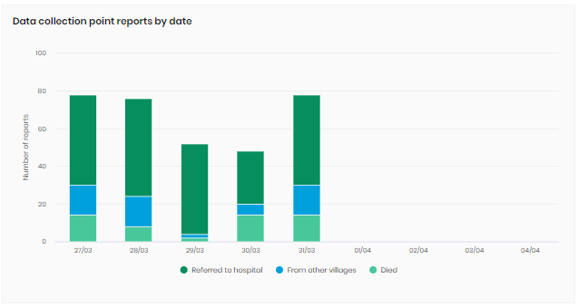
Projects
Project Dashboard
DEMO
Data collection points
Only shows when you filter on data collection points
Shows reports for some additional fields that data collection points can report on
Upon hovering it shows the number of reports
By clicking on the health risks/events in the legend you can in-/exclude what is shown in the bar chart
NYSS TRAINING GUIDE
Version 1.0

Slide 43
Projects
Project Dashboard
TASKS
Instructions:
Log into Nyss
Answer the questions
Play a little with the different filters in the box at the top. Do you know what all of them do and why they might be useful?
Do you know what the information in all the boxes at the top mean? E.g. do you know what the different states of alerts are?
Check out all the bar charts and play around with them. Do you know what they can be used for? Can you explain why the number of reports in the sex/age bar charts is different from the others?
Can you show the graph that is only visible for data collection points?
Answers to some questions:
Escalated: Supervisor cross-checked and notified health authorities, Dismissed: Supervisor cross-checked and found the alert to not be valid, Closed: Escalated and health authorities have dealt with it
The sex/age bar chart only shows human health risks, e.g. no Unusual Events.
Activate filter for Data Collection Point
NYSS TRAINING GUIDE
Version 1.0

Slide 44
Projects
Project Dashboard
DISCUSSION
How did it go?
When do you think is it useful to use the dashboard?
Do you know in which way the various graphs can be used to facilitate early response?
NYSS TRAINING GUIDE
Version 1.0

Slide 45
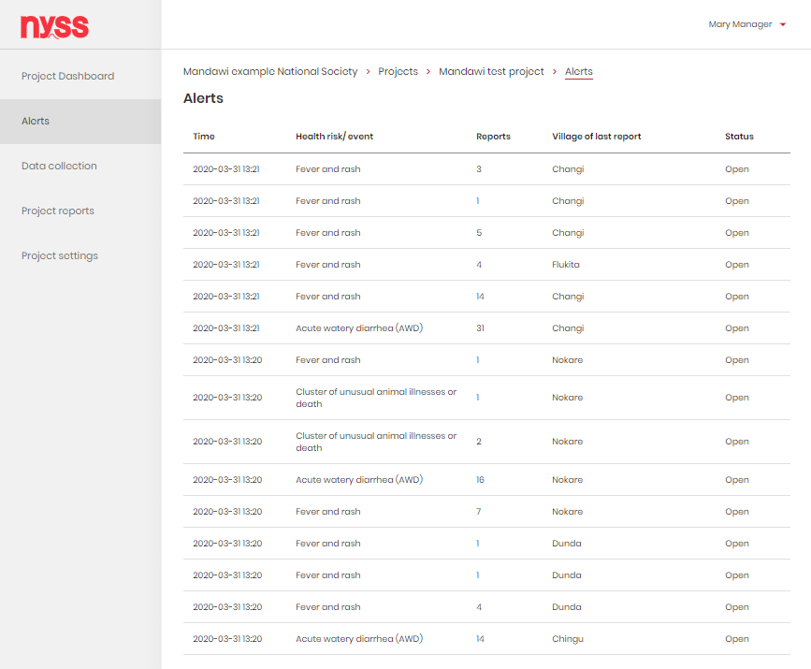
DEMOS AND TASKS
National Society
Dashboards
Reports
User list
Settings
Projects
Project Overview
Project Dashboard
Alerts
Data Collection
Project Reports
Project Settings

Slide 46
Projects
Alerts
DEMO
Accessible by managers, technical advisors and supervisors.
Gives an overview of:
All the alerts triggered within the project
Refer to the Nyss manual for more information on triggering of alerts
Each alert can be clicked for more information, and to dismiss, escalate or close the alert
NYSS TRAINING GUIDE
Version 1.0
Notes:
Relevant for:
Managers (Head manager, Manager, Technical Advisor)
Supervisor

Slide 47
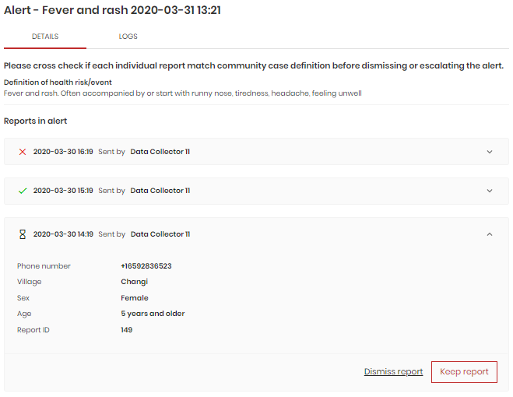
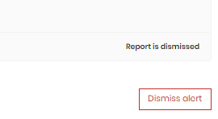
Projects
Alerts
DEMO
Dismissal
When an alert is triggered, the reports that triggered it are cross-checked by the connected supervisors
In the example the top report was dismissed, the second was kept and the bottom one is opened for more information.
In this case the alert rule was two reports. If the third report is dismissed, the alert rule is not met anymore, and the alert can be dismissed.
NYSS TRAINING GUIDE
Version 1.0
Notes:
Relevant for:
Managers (Head manager, Manager, Technical Advisor)
Supervisor

Slide 48
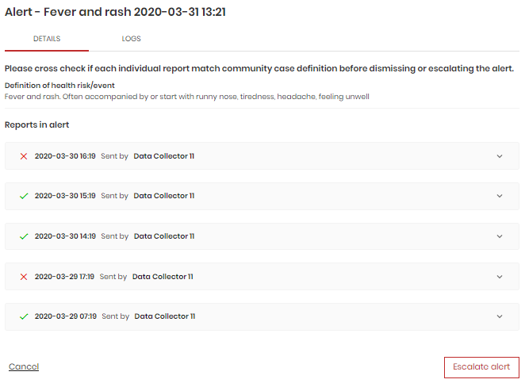
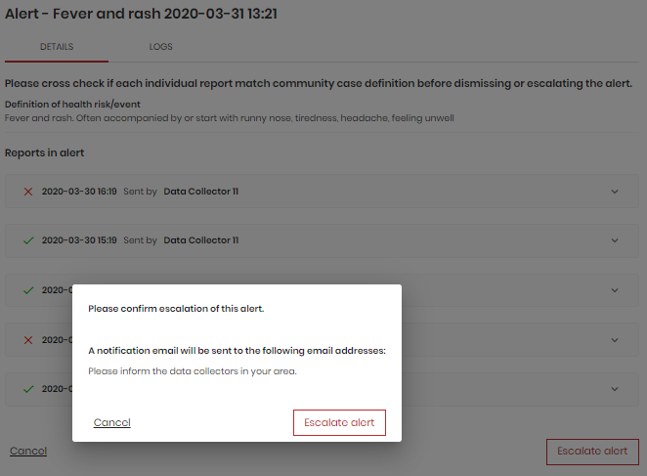
Projects
Alerts
DEMO
Escalation
When an alert is triggered, the reports that triggered it are cross-checked by the connected supervisors
In the example two reports were dismissed and three were kept
In this case the alert rule is still met after cross-checking, and the alert should be escalated
Escalating automatically notifies health authorities or others set as notification recipients
NYSS TRAINING GUIDE
Version 1.0
Notes:
Relevant for:
Managers (Head manager, Manager, Technical Advisor)
Supervisor

Slide 49
Projects
Alerts
TASKS
Instructions:
Log into Nyss
Answer the questions
Go to the alerts list: How many reports are included in each of the three first alerts, and what health risk is the alert of?
Click on one alert: How do you collect information to know if you should keep or dismiss the report?
Try to keep 3 reports.
Try to dismiss 3 reports.
Escalate an alert.
What happens when you escalate an alert?
How do you set the recipients of alert notifications?
Close the alert you escalated.
When would closing an alert be appropriate?
NYSS TRAINING GUIDE
Version 1.0

Slide 50
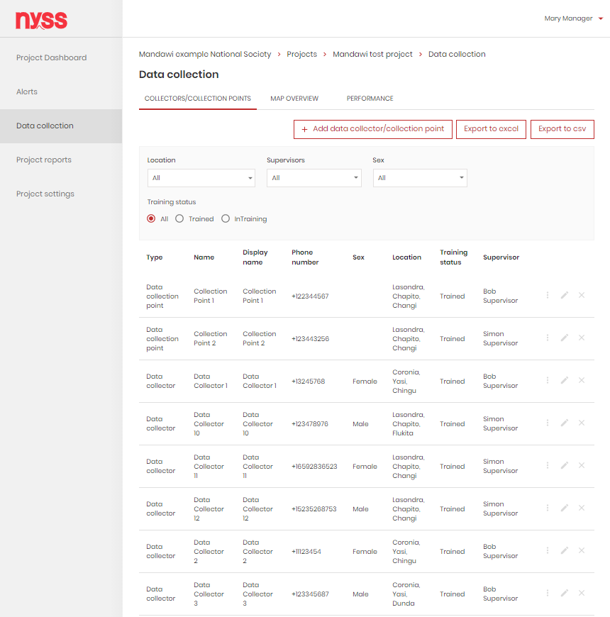
DEMOS AND TASKS
National Society
Dashboards
Reports
User list
Settings
Projects
Project Overview
Project Dashboard
Alerts
Data Collection
Project Reports
Project Settings

Slide 51
Projects
Data Collection
DEMO
Accessible by managers, technical advisors and supervisors.
Gives an overview of:
All data collectors and data collection points within the project
Supervisors can only see data collectors and data collection points that are assigned to them
NYSS TRAINING GUIDE
Version 1.0
Notes:
Export to excel (only managers)
Export to csv (only managers)

Slide 52
Projects
Data Collection
DEMO
Accessible by managers, technical advisors and supervisors.
Possible to:
Data Collectors status can be switched between In training and Trained
Data Collectors can be edited, removed…
…and added
NYSS TRAINING GUIDE
Version 1.0
Notes:
Export to excel (only managers)
Export to csv (only managers)

Slide 53
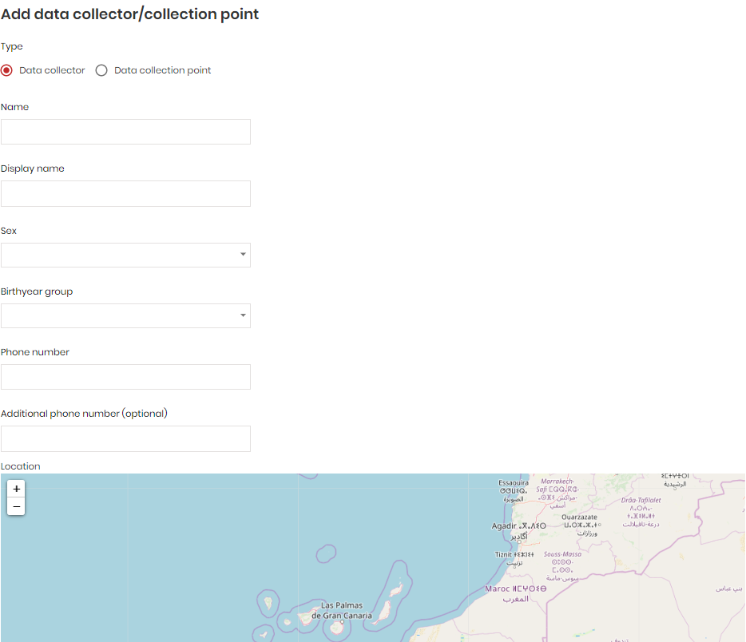
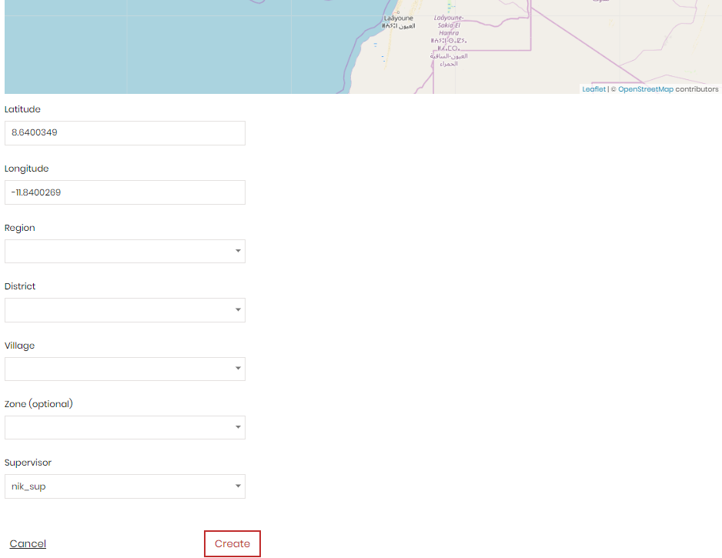
Projects
Data Collection
DEMO
Add data collector/ collection point
Display name = what is shown on map
Phone number must include country code (+47 etc.)
Location can be either entered with latitude and longitude or selected by clicking on the map. On mobile devices you can also retrieve it from your device
NYSS TRAINING GUIDE
Version 1.0

Slide 54
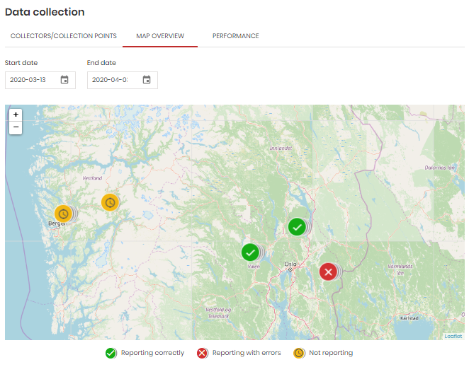
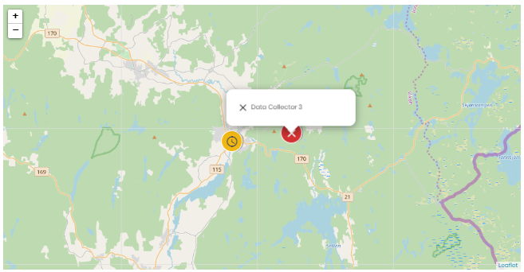
Projects
Data Collection
DEMO
Map overview:
See the performance of data collectors/collection points on a map
Not reporting means they have not sent any reports in the past 7 days
Click on a dot to see which data collector it is
NYSS TRAINING GUIDE
Version 1.0

Slide 55
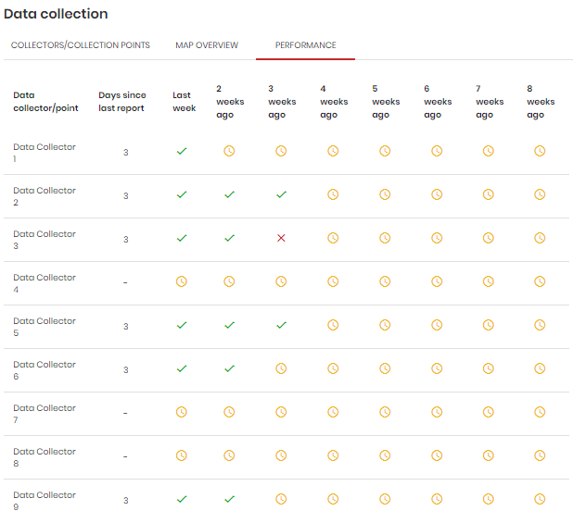
Projects
Data Collection
DEMO
Performance:
Same data, but split into the last 8 weeks
Does not adhere to any filters set in the map overview
Data collectors that have not sent in reports are marked as Not reported that week
Days since last report is also shown
NYSS TRAINING GUIDE
Version 1.0

Slide 56
Projects
Data Collection
TASKS
Instructions
Add a few data collectors and/or data collection points with different locations
Play a bit with the filters and make yourself familiar with the different columns
Answer question A-C
Check out some data collectors and their locations
Answer question C
Go to the performance-page
Answer question D-I
Why is it important that the number of a data collector is registered correctly in the platform?
What do these numbers mean: 2#2#1?
Can you identify which data collectors have been trained in CBS and which are being trained?
What is a data collection point?
What do the different icons mean? What is the purpose of the inactive (not reporting) state of data collectors?
How can you use the information under Data collection to improve the quality of the CBS work?
Which data collectors you would follow up, and why?
What is the difference between the inactive state on the performance page and the map overview?
NYSS TRAINING GUIDE
Version 1.0

Slide 57
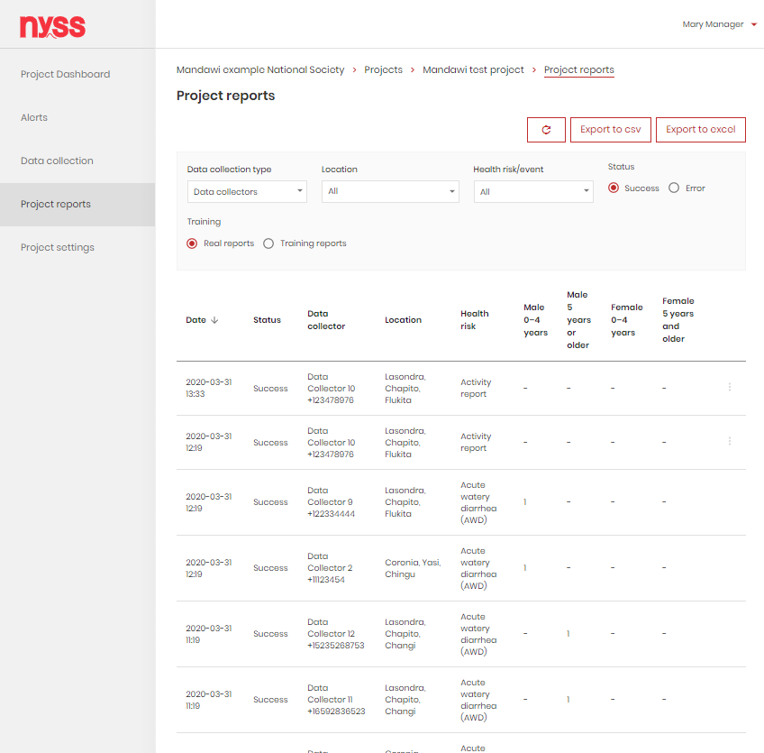
DEMOS AND TASKS
National Society
Dashboards
Reports
User list
Settings
Projects
Project Overview
Project Dashboard
Alerts
Data Collection
Project Reports
Project Settings
National Society
Projects
Project Overview
Project Dashboard
Alerts
Data Collection
Project Report
Project Settings
Userlist
Settings

Slide 58
Projects
Project Reports
DEMO
Accessible by managers, technical advisors and supervisors.
All reports in line list
Refresh without reloading the page (e.g. to not use filter settings)
Can be filtered by:
Data collection type
Location
Health risk/event
Status
Real/Training reports
NYSS TRAINING GUIDE
Version 1.0
Notes:
Relevant for:
Managers (Head manager, Manager, Technical Advisor)
Supervisor

Slide 59
Projects
Project Reports
DEMO
Successful reports show
Health risk/event
Age and sex reported if applicable
NYSS TRAINING GUIDE
Version 1.0
Notes:
Relevant for:
Managers (Head manager, Manager, Technical Advisor)
Supervisor

Slide 60
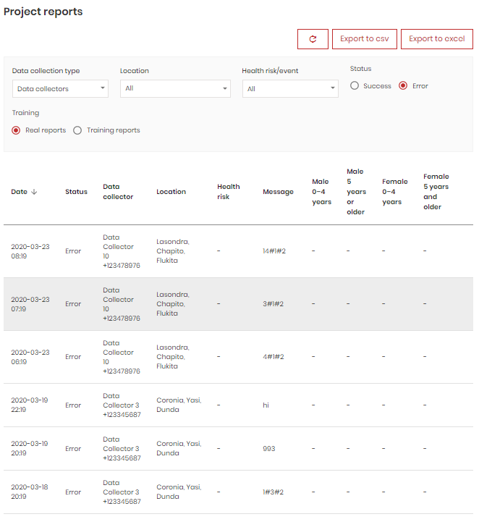
Projects
Project Reports
DEMO
Error reports show
No health risk/event, sex or age, as Nyss could not interpret the report
The raw text of the message so that the error can be analyzed
NYSS TRAINING GUIDE
Version 1.0
Notes:
Relevant for:
Managers (Head manager, Manager, Technical Advisor)
Supervisor

Slide 61
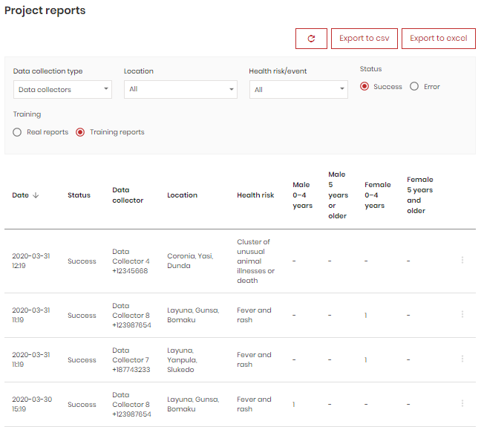
Projects
Project Reports
DEMO
Training reports
Shown when filtering on Training reports
Same info as Real reports, with one notable difference:
Training reports can be marked as error
NYSS TRAINING GUIDE
Version 1.0
Notes:
Relevant for:
Managers (Head manager, Manager, Technical Advisor)
Supervisor

Slide 62
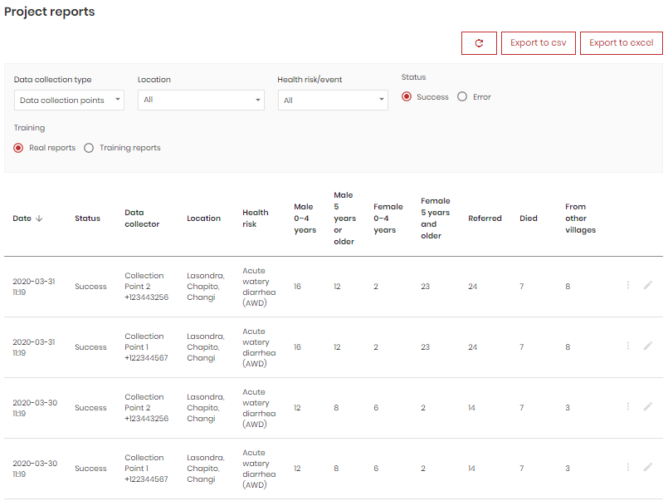
Projects
Project Reports
DEMO
Data collection point reports
Shown when filtering on Data collection points
Shows additional columns that data collection points can report on
Successful reports can be marked as error
Successful reports can also be edited by managers
NYSS TRAINING GUIDE
Version 1.0
Notes:
Relevant for:
Managers (Head manager, Manager, Technical Advisor)
Supervisor

Slide 63
Projects
Project Reports
TASKS
Instructions:
Log into Nyss
Answer the questions
Check out the different types of reports. Do you know what the difference between data collectors and data collection points are? What do they refer to in a CBS implementation?
What does “In training” mean?
When should the data collectors start with “real reports”?
Find three erroneous reports from the last month. Why couldn’t Nyss interpret them?
Export the data to Excel. When can this function be valuable?
NYSS TRAINING GUIDE
Version 1.0

Slide 64
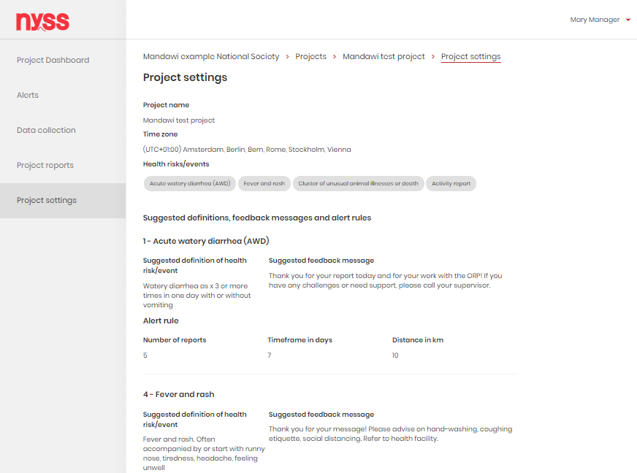
DEMOS AND TASKS
National Society
Dashboards
Reports
User list
Settings
Projects
Project Overview
Project Dashboard
Alerts
Data Collection
Project Reports
Project Settings

Slide 65
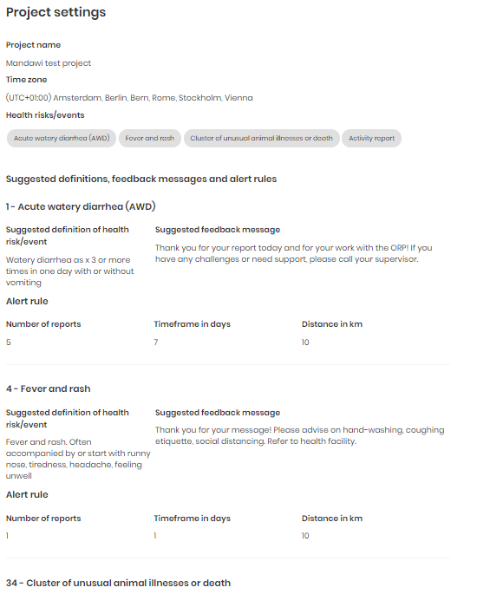
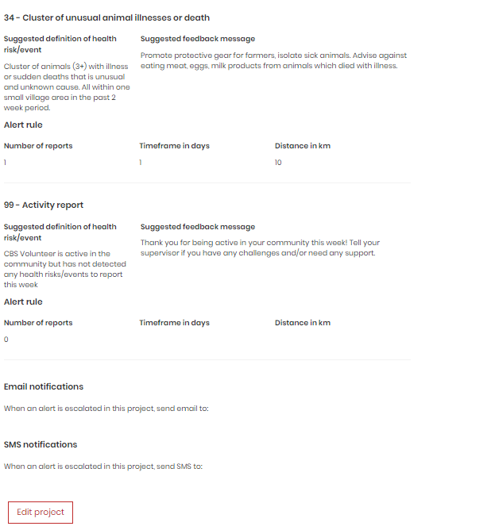
Projects
Project Settings
DEMO
Accessible by managers, technical advisors and supervisors, but supervisors cannot edit.
Name
Time zone
Health risks/events and their definitions, feedback messages and alert rules
Escalated alert notification recipients
Managers and technical advisors may edit
NYSS TRAINING GUIDE
Version 1.0
Notes:
Relevant for:
Managers (Head manager, Manager, Technical Advisor)
Supervisor

Slide 66
Projects
Project Settings
TASKS
Instructions:
Log into Nyss
Answer the questions
Go to the project settings and check out the different options. Do you know what they mean and why they are there?
Why do you have to add specific health risks/events to a project?
Which language will show in the suggested definition and feedback message fields?
Can you explain what the logic behind escalation notifications is? Why are they important in the CBS cycle?
NYSS TRAINING GUIDE
Version 1.0

Slide 67
3. QUESTIONS AND DISCUSSION

